Slide 1

Maternal Mortality Ratio in India: An Exploration
This presentation explores the complex relationship of Maternal Mortality Ratio with indicators like Poverty Rate and Life Expectancy of women in India. We will examine socioeconomic factors. We also focus on healthcare access and government initiatives.
Presentation By -
Ananya Khanduri
23375007 (Regular)
MSc 2nd Year

Slide 2

OVERVIEW
Objective
Introduction
Maternal Mortality Ratio
Poverty Rate
Life Expectancy
About the Data
Visualisations and Comparison
Causes and Solutions
Bibliography

Slide 3
ABSTRACT
This study aims to:
Analyze the relationship between maternal mortality with respect to life expectancy and Poverty Rate among various states in India.
2. Identify states with high maternal mortality and lower life expectancy.
3. Explore other contributing factors that affect MMR.
4. Provide policy recommendations for improving maternal health and life expectancy.

Slide 4

Defining Maternal Mortality Ratio (MMR): Measurement and Significance
1
Definition of MMR
2
Calculation
3
Significance of MMR
MMR is the number of maternal deaths per 100,000 live births. Deaths occur due to pregnancy or its management.
The MMR is calculated by dividing maternal deaths by total live births. The result is then multiplied by 100,000.
MMR reflects quality of maternal healthcare. It indicates a nation's overall health infrastructure.

Slide 5
Understanding Life Expectancy: Definition, and Global Comparisons
Definition
Global Data
Significance
Life expectancy is the average number of years a person is expected to live. This is based on statistical probabilities.
Global life expectancy varies. Developed nations often have higher rates due to better healthcare and living conditions.
Life expectancy serves as an indicator. It reflects a population's overall health and well-being.

Slide 6

Poverty:
Definition
Poverty is when a person or family doesn't have enough money to meet their basic needs. This can include food, clothing, shelter, healthcare, and education.
Poverty Rate
Note:
Over the last several decades, India has become one of the fastest growing economies in the world. But even with this impressive progress, poverty in India continues to be an enormous problem. A small percentage of people in India have benefitted from this growth, while the vast majority still struggle to meet their basic daily needs.
Poverty rate is the ratio of the population whose income falls below the poverty line.
The poverty line is taken as half the median household income of the total population. The population affected is broken down by broad age groups: child poverty (0-17 years old), working-age poverty (18-65 years old) and elderly poverty (66 year-olds or more).
The September 2023 Global Poverty Update by the World Bank revealed that at the $3.65 poverty line, India accounts for 40% of the global poverty rate of 24.1%. (The World Bank)
Between 2012 and 2021, 40% of the wealth created in India has been captured by just the wealthiest 1% of the population. (BBC)

Slide 7
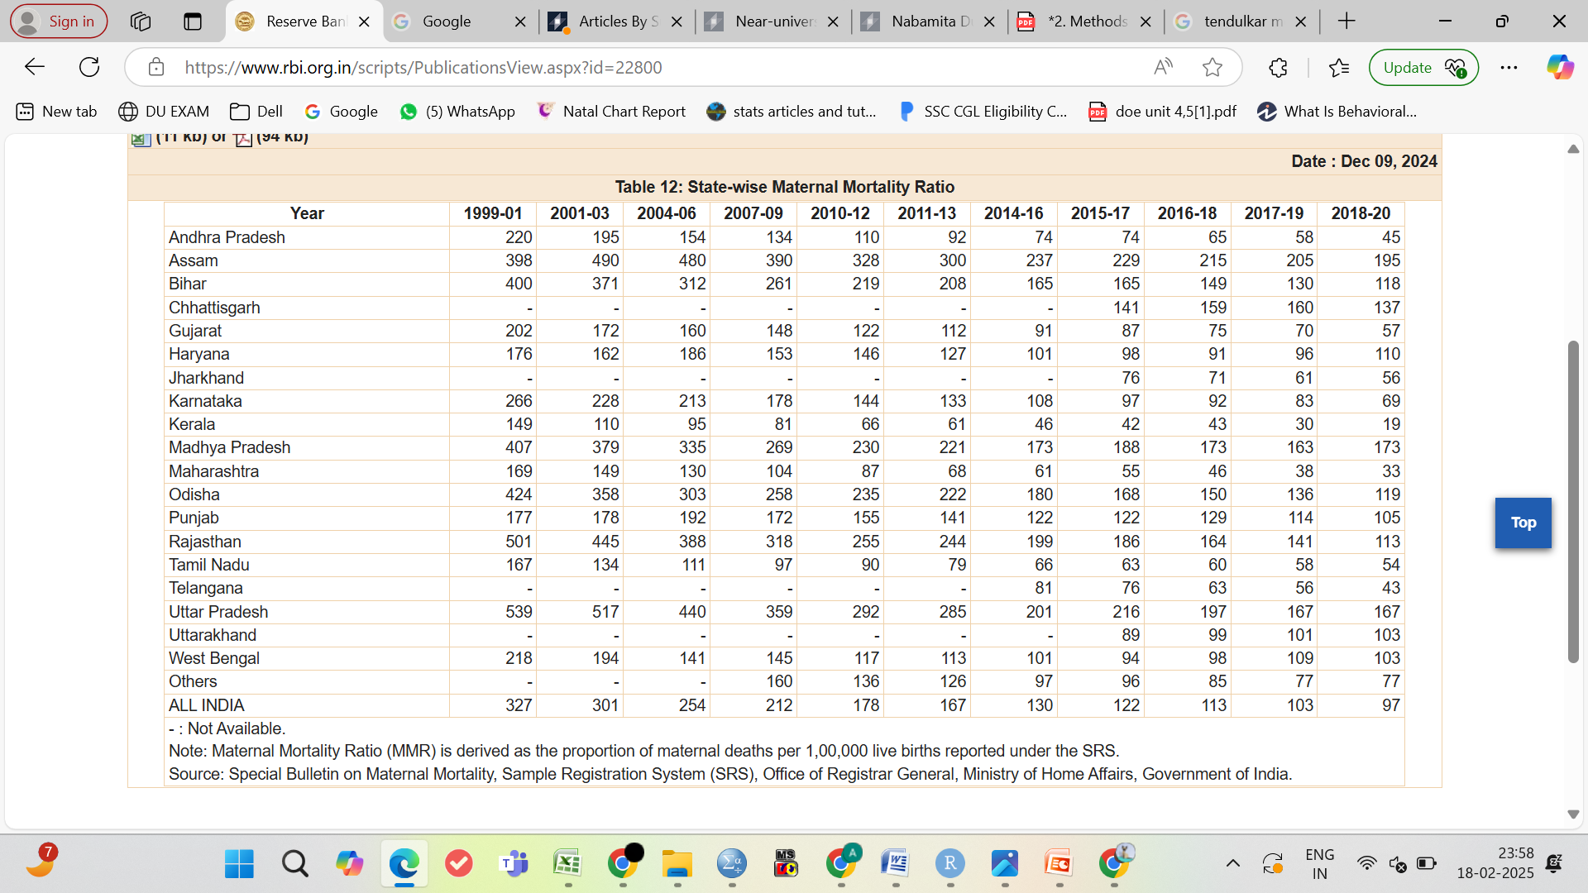
About the Data
This dataset collection aims to analyze the relationship between maternal health, poverty, and life expectancy in different states of India.
The data has been collected from the official website of the Reserve Bank of India.
Maternal Mortality Ratio (MMR) indicates the number of maternal deaths per 100,000 live births, reflecting healthcare access and maternal health.
Poverty Data shows the percentage and number of people below the poverty line, which influences healthcare access and maternal outcomes.
Life Expectancy provides an overall measure of health and well-being in different regions.

Slide 8
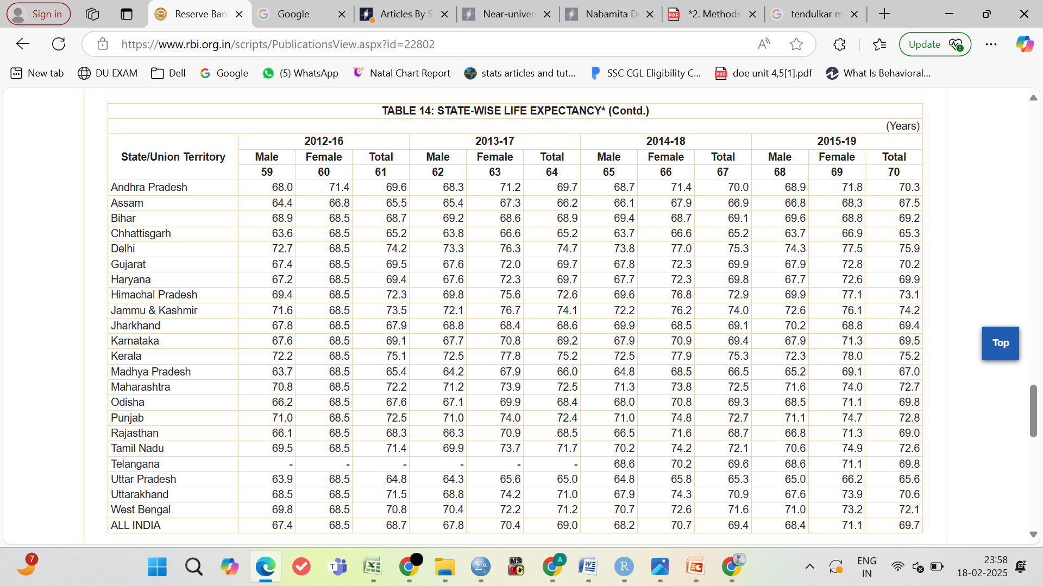
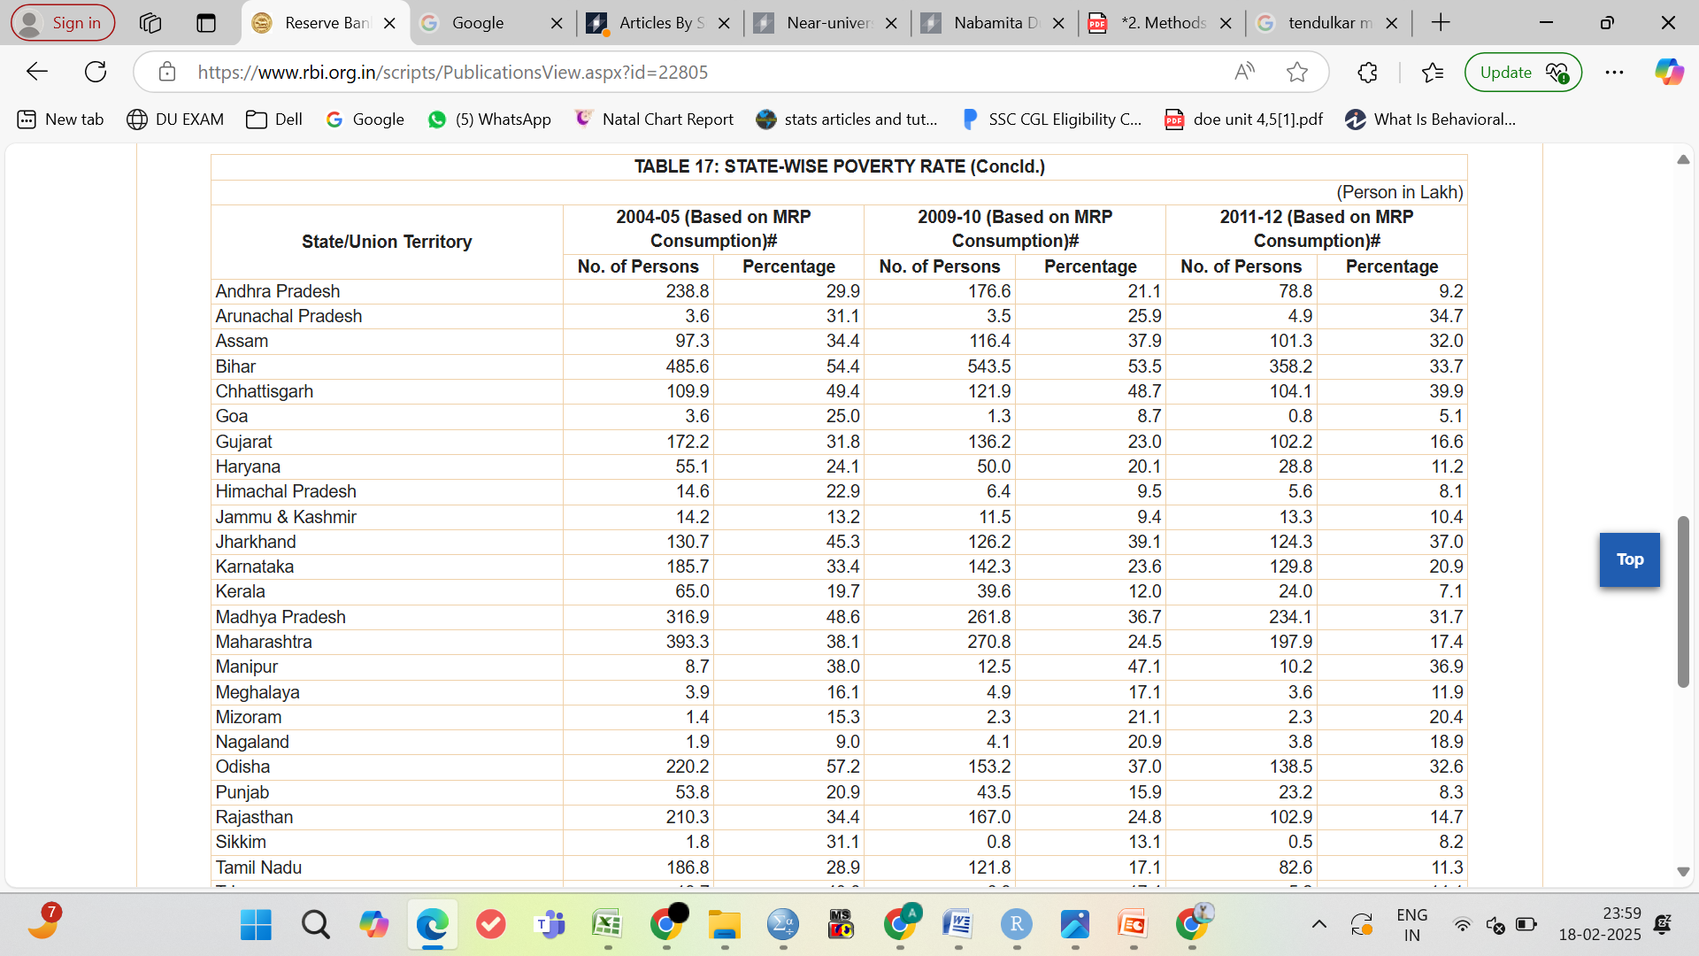

Slide 9
Trend Analysis and Comparison
Trend Analysis:
Examines patterns in MMR, poverty levels, and life expectancy over time.
Identifies whether maternal mortality is decreasing or increasing and how it correlates with socio-economic factors.
Comparative Analysis:
Evaluates regional differences in MMR based on poverty rates and life expectancy.
Highlights states with higher/lower MMR and their socio-economic conditions.
Identifies potential policy impacts on improving maternal health outcomes.

Slide 10
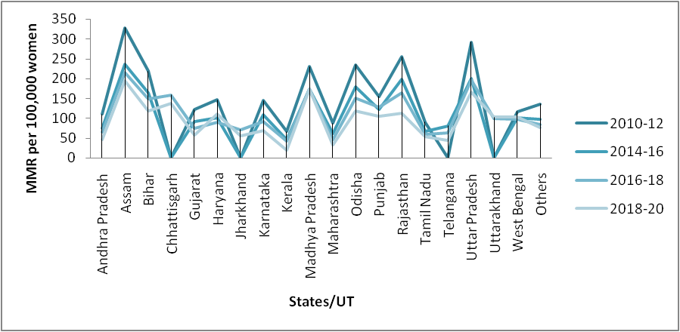
Historical Trends: MMR in India and its states over time
MMR trend for all states over the years. Each line represents a state's maternal mortality ratio, showing how it has changed over time.

Slide 11
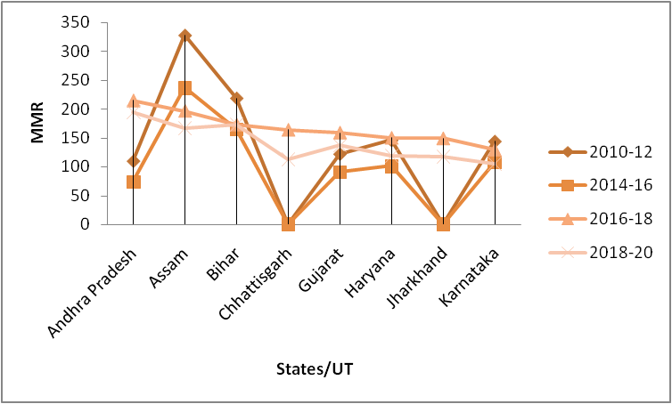
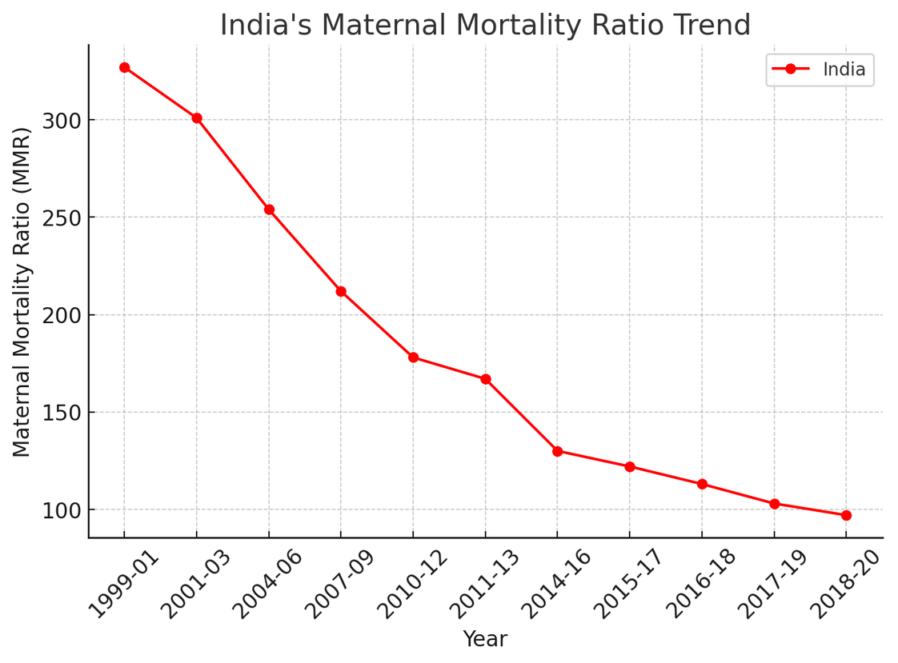
Historical Trends: MMR in India Over Time

Slide 12
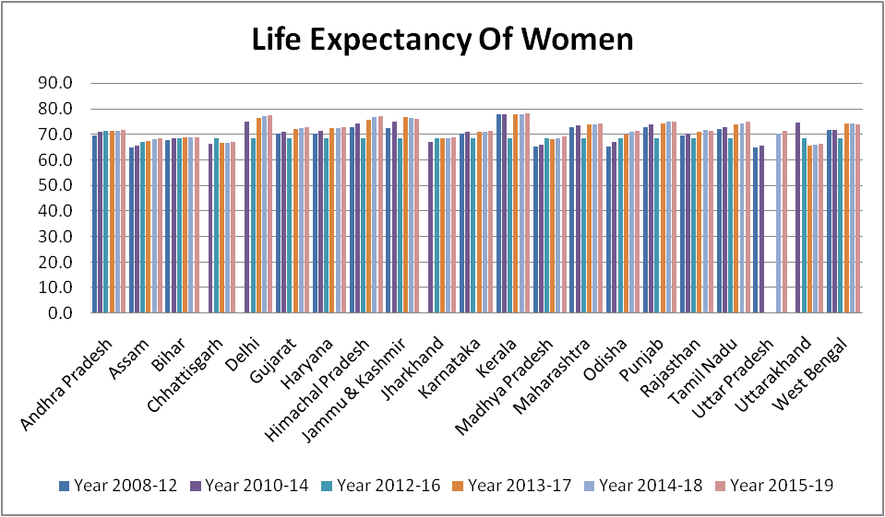
Comparison of Life Expectancy Across States
Life Expectancy trend for all states over the years. Each line represents a state's life expectancy of women, showing how it has changed over time.

Slide 13
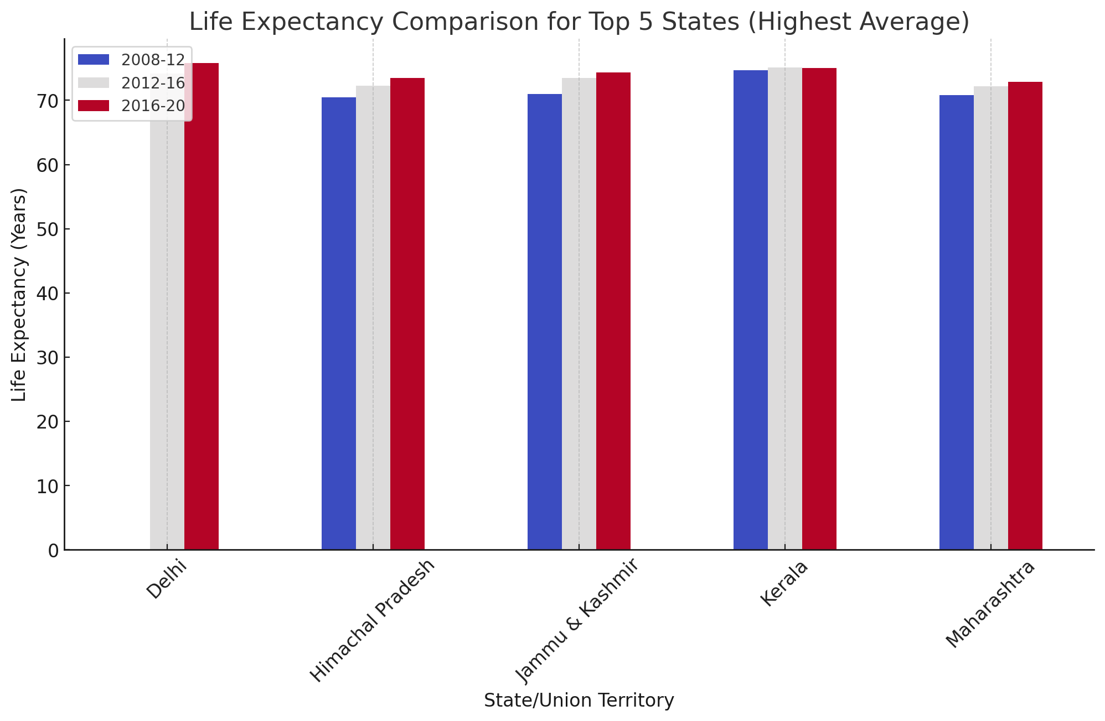
Top 5 states having highest life expectancy

Slide 14
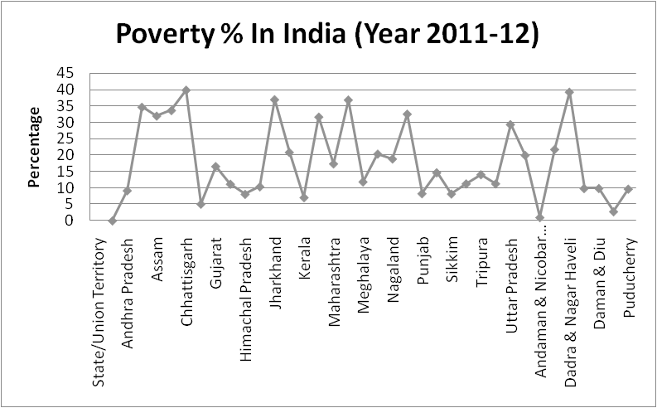
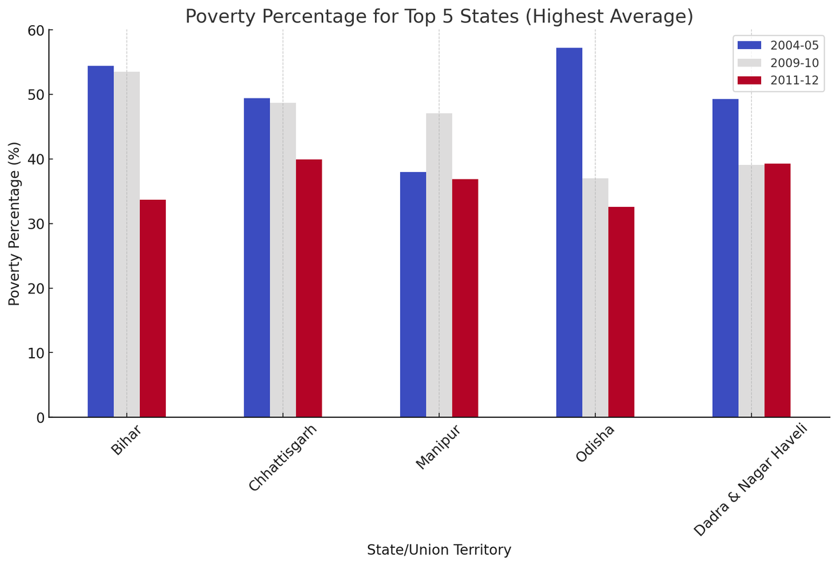
Poverty Percentage Across states over time:
India's poverty rate falls below 5% in 2024, extreme poverty nearly eradicated: SBI Report.
Bihar is the poorest state in India, according to the Multidimensional Poverty Index (MPI).

Slide 15
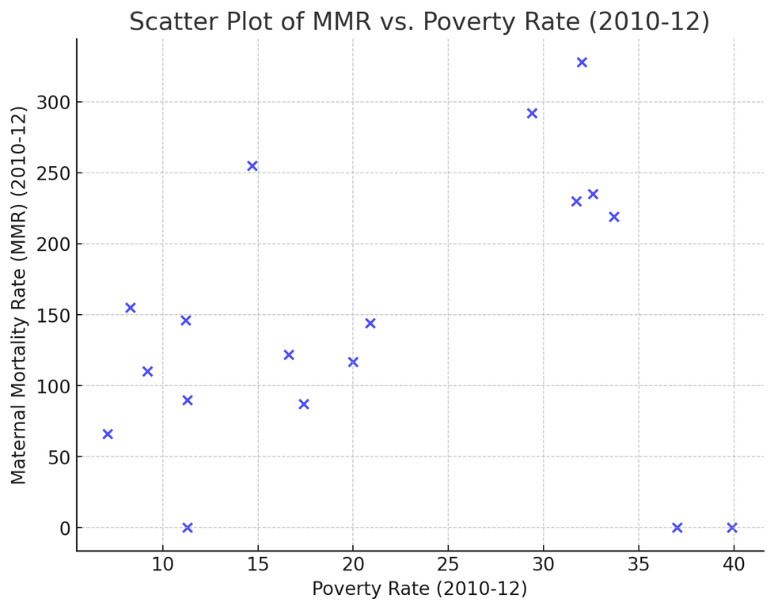



Relation between MMR and Poverty Rate
Direct Relationship
Positive Correlation Trend – There seems to be a general trend where states with higher poverty rates also tend to have higher MMR. This suggests that poverty may be a contributing factor to maternal mortality.
Outliers – Some states have very high MMR despite not having the highest poverty rates (e.g., Assam with an MMR of 328). Similarly, some states with relatively high poverty rates do not have extremely high MMR.
Clusters – A majority of states seem to fall within a mid-range for both poverty rate and MMR, but a few states have significantly higher or lower values.

Slide 16
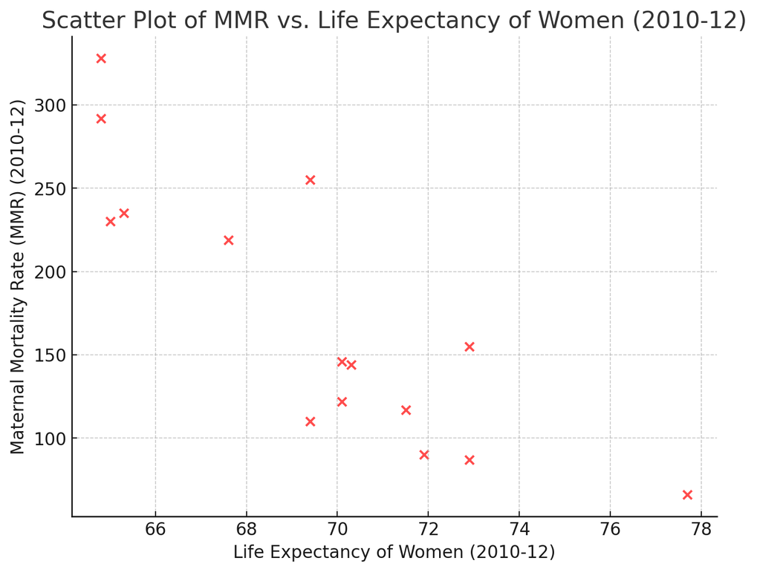
Correlation Analysis: Is there a relationship between the MMR and Life Expectancy
Inverse Relationship
The trend appears to suggest a negative correlation, meaning that states where women have higher life expectancy tend to have lower maternal mortality rates.
Complex Factors
This confirms that higher maternal mortality is linked to lower overall life expectancy, likely due to poor healthcare, nutrition, and living conditions in states with high MMR.
Statistical analysis helps quantify the strength and nature of the relationship between life expectancy and MMRStates with lower life expectancy (e.g., Assam) tend to have higher MMR, while states with higher life expectancy (e.g., Gujarat) tend to have lower MMR..

Slide 17

Factors Influencing MMR in India: Healthcare Access, Nutrition, and Education
2. Socioeconomic & Systemic Causes (Indirect Causes)
Poverty & Malnutrition → Poor women have less access to quality healthcare & nutrition, leading to higher risks.
Limited Access to Healthcare → Poor transportation, lack of hospitals, and high costs prevent timely medical help.
Low Female Education & Awareness → Lack of knowledge about maternal health & family planning leads to preventable complications.
1. Medical Causes (Direct Causes)
These account for 75-80% of maternal deaths.
Severe Bleeding (Postpartum Hemorrhage - PPH) Leading cause of maternal deaths worldwide.
Infections (Sepsis) → Poor hygiene and untreated infections during/after childbirth.
Obstructed Labor & Uterine Rupture → Prolonged labor without medical intervention.
3. Poor Health Infrastructure & Government Policies
Weak Referral Systems → Delay in transferring critical patients to higher medical facilities.
Shortage of Doctors & Midwives → Many states lack trained obstetricians & gynecologists.
Inadequate Prenatal & Postnatal Care → Many women do not get regular check-ups.

Slide 18


How to reduce this ratio?
Better Healthcare Access: More hospitals, trained birth attendants, and emergency care.
Improved Nutrition & Hygiene: Reducing anemia, infections, and malnutrition in pregnant women.
Education & Awareness: Teaching women about maternal health, contraception, and safe childbirth.
Stronger Policies & Funding: More government investment in maternal healthcare programs.

Slide 19
Government Initiatives and Programs: Addressing Maternal Health Challenges
The Government of India has several policies to reduce maternal mortality, including financial support, free healthcare, and tracking high-risk pregnancies.
Financial support
Janani Suraksha Yojana (JSY): A conditional cash transfer scheme to promote institutional deliveries
Janani Shishu Suraksha Karyakram (JSSK): Free delivery, including C-sections, for pregnant women and sick infants in public health institutions
Free healthcare
Surakshit Matritva Aashwasan (SUMAN): Free, quality healthcare for women and newborns in public health facilities
Pradhan Mantri Surakshit Matritva Abhiyan (PMSMA): Free antenatal checkups for pregnant women on the 9th of every month
Government programs promote institutional deliveries. They focus on improving maternal nutrition. These initiatives aim to reduce MMR and enhance life expectancy.

Slide 20
Future Directions: Policy Recommendations and the Path Forward
Investment
1
Increase investment in healthcare infrastructure and human resources. Prioritize maternal and child health services.
2
Education
Promote girls' education. Empower women with knowledge and skills.
Equity
3
Address socioeconomic disparities. Ensure access to quality healthcare for all.
Continued efforts are needed to improve life expectancy and reduce MMR in India. This requires a multi-faceted approach.

Slide 21
Bibliography
https://www.rbi.org.in/scripts/AnnualPublications.aspx?head=Handbook+of+Statistics+on+Indian+States -RBI Website
The Methods and Materials of Demography Henry S. Shryock Jacob S. Siegel and Associates
https://outreach-international.org/blog/poverty-in-india/ - Outreach International
https://www.sciencedirect.com/science/article/pii/S0190740920321460 - ScienceDirect

Slide 22
THANK YOU!

